Slide 1
Alex Kaplan
Career Foundry
Data Immersion Portfolio
Instacart Analysis

Slide 2

Instacart Grocery Basket Analysis
Objective
Instacart is an online grocery store that operates through an app. Instacart already has very good sales, but they want to uncover more information about their sales patterns. Our task is to perform an initial data and exploratory analysis of some of their data to derive insights and suggest strategies for better segmentation based on the provided criteria.
Overview
The stakeholders at Instacart are interested in the variety of customers in their database along with their purchasing behaviors. They are contemplating a targeted market strategy as they believe that they cannot use the same methods to reach everyone. They want to target different customers with applicable marketing campaigns to see if they have an impact on the sale of their products.

Slide 3
Questions from the Sales and Marketing Team
What are the busiest days and hours?
What time of day to people spend the most money?
Which departments are products purchased from the most?
What are the buying habits of family vs nonmarried?
Which type of customer status makes up the majority of Instacart’s overall customers?

Slide 4
Data
Customers Data Set Instacart Customers Dataset
Data Dictionary Instacart Data Dictionary
Tools
Python, Jupyter Lab, Pandas, Seaborn and Matplotlib libraries
Skills
Data Cleaning
Data Grouping
Data Merging
Data Aggregation
Exploratory Analysis
Deriving New Variables
Descriptive Statistics
Reporting in Excel
Visualizations

Slide 5
Project Phases
1. Data Preparation Phase
The first step was to clean the original Instacart Dataset provided by CareerFoundry. I did this by checking for missing values, inconsistent data types, and deleting any unneeded columns. I knew the questions that needed to be answered for this project, so I derived new variables to conduct the analysis.
2. The Analysis Phase
I divided the questions to give some organizations to the analysis into three sections: time analysis, department analysis, and customer profiling analysis.
3. The Results Phase
Even data from Instacart was trustworthy and accurate, some limitations were present during each phase. The stakeholders were made aware of these limitations when the results were presented.

Slide 6
1. Time Analysis
Questions
Determine the days of the week and hours of each day with the least number of orders.
Determine the times of day with the greatest number of orders.
Limitations
Data did not have actual prices of each product, nor did it have the quantities of the products ordered.
Solutions
The analysis used the number of unique orders and their distribution for the days and hours of the week.

Slide 7
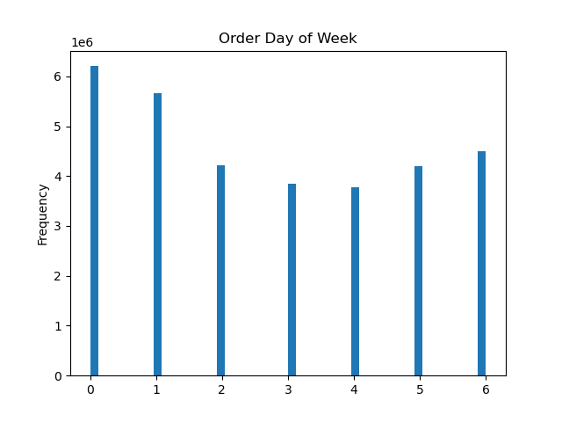
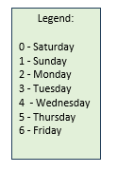
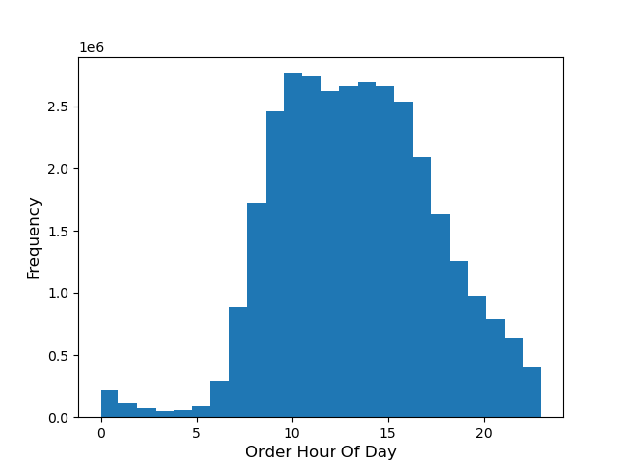
1. Time Analysis Visualizations
Bar charts were implemented to display the number of orders per day and the hours of each day.
The analysis showed the days with the greatest number of orders were Saturday and Sunday which makes sense since many people shop on the weekends.
It also showed the busiest hours on Instacart were between 9am-4pm

Slide 8
2. Department Analysis
Questions
The marketing and sales teams want to know which departments have the highest frequency of product orders
What are the buying habits of family vs nonmarried?
Limitations
Data did not have actual prices of each product, nor did it have the quantities of the products ordered.
Solution
The analysis focused on the number of times items were ordered from various departments.

Slide 9
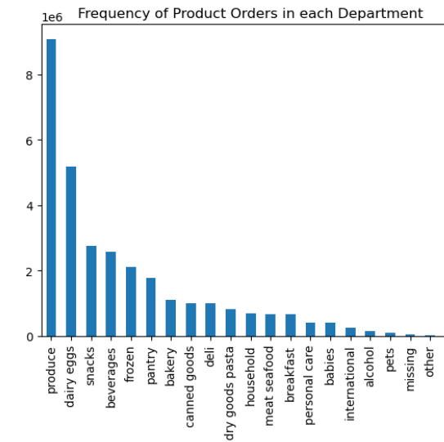
2. Department Analysis Visualizations
Produce is the best-selling department on Instacart, with sales nearly double that of the next most popular department, dairy eggs.
The lowest selling departments are bulk, babies, and pet items.
I would have preferred to determine the popularity of each department by the quantity of products sold. However, since that information was not provided, I listed departments based on the total number of times products from a specific department were ordered.

Slide 10

3. Customer Profiling Analysis
Questions
Determine if age and income play any factor in how often customers order from Instacart.
Determine the ordering habits and behavior of the customers.
Limitations
The data’s behavioral and demographical information was fabricated for the purposes of learning the processes.
Solution
The dataset was still used as is.

Slide 11
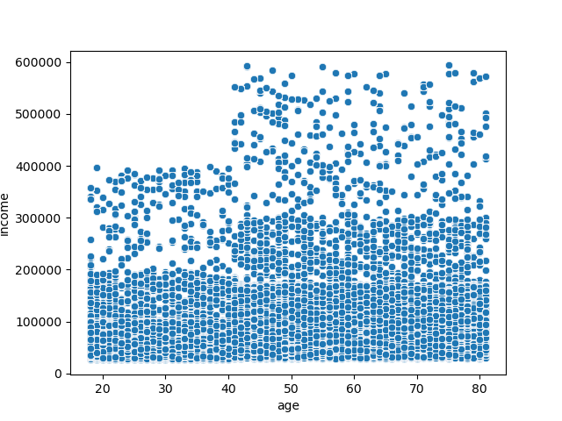
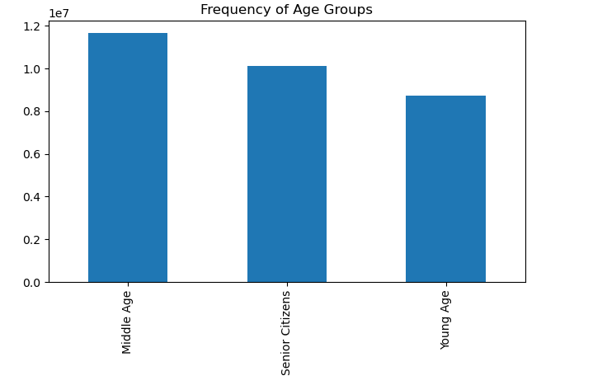
3. Customer Profiling Analysis – Age & Income
Defining ordering habits was taxing because the data had many variables combinations to examine. Ultimately, I chose to focus on age and income.
As customers turn 40, their income tends to increase compared to customers under 40.
The bottom chart shows the biggest proportion of Instacart's customers are middle age (35-60), followed by senior citizens (61+) and young age(<35) respectively.

Slide 12
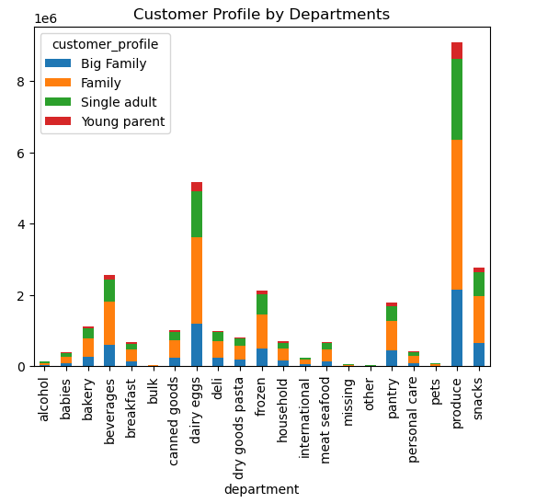
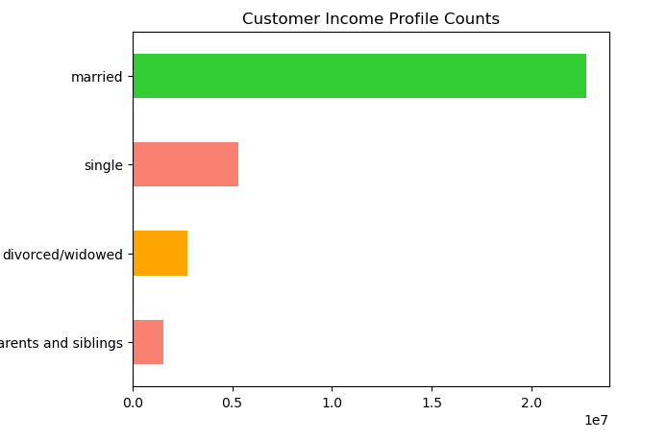
3. Customer Profiling Analysis: Ordering Habits & Status
Families (with at least one child) have the highest proportion of orders for Instacart. We can also see that single adults have the second highest proportion of Instacart's orders.
Based on family status, most of Instacart's customers are married with a dependent living with them and second most customers are single living with no dependents. Regardless of family status, all customers tend to order mid ranged products.

Slide 13
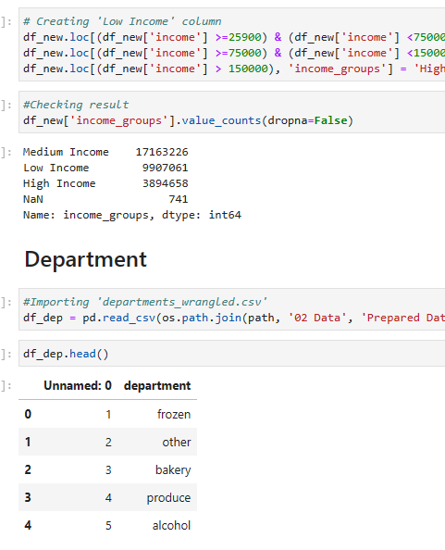
Conclusions & Recommendations
According to an analysis, Instacart is busiest between 9am-4pm on Saturdays and Sundays. The most popular department on Instacart is produce. Additionally, it appears that married people make up the largest proportion of Instacart’s customers.
It might be a good idea to offer promotions on lower sold items such as bulk and pet items to help increase their sales. It may be beneficial to have advertisements during the slow periods of the day between 12am-7am and to offer deals to customers who order during this slower time.
Even though I answered the questions, I was always aware of the fact that the answers I provided did not paint the entire picture since some of the data values were missing. I wondered if the results of the data would be any different if the values were not missing.
Technically speaking working with a dataset that has over 30 million rows was problematic due to the amount of RAM it took to run the code necessary for this analysis. To help with this issue, I optimized the code by splitting the data into chunks.

Slide 14


Thank you!
If you enjoyed reading about this analysis, please click the links below to see more Python code and additional insights.

